Slide 1
www.theipna.org
IPNA is a global, nonprofit charitable organization that believes that all children deserve to be healthy and receive optimal treatment and care for kidney disease regardless of their economic level or political choice.

Slide 2
IPNA Mission
IPNA‘s mission is to lead the global efforts to enhance the care for all children with kidney disease through advocacy, education, training and research.
1,848
members
119
From 119 countries
300
Over 300 Fellows trained worldwide

Slide 3
IPNA Membership benefits
25% textbook discount on all English-language Springer Books.
Substantial reduction in Registration rates for the 20th IPNA Congress, February 19–23, 2025, Cape Town, South Africa.
Opportunities for global educational programs, networking and sharing resources.
On-line access to Pediatric Nephrology Textbook (8th edition), a benefit of > US$ 1,000 value!
Free access to the ISN Academy, the official eLearning portal of the ISN.
Full access to the Journals Pediatric Nephrology, European Journal of Pediatrics and International Urology and Nephrology.
Exclusive access to the IPNA App with many useful functionalities.
Exclusive access to recordings from the IPNA Congress 2022.

Slide 4
IPNA New membership category for Trainees
FREE
FREE membership with IPNA until they complete their training program or transition into their roles as consultant nephrologists
Information Required:
Nephrology Program Supervisor‘s Name, E-mail, Phone Number, and Institution
Current Year of Training and Anticipated Completion Date
Confirmation from the Supervisor, validating the Trainee Status

Slide 5
IPNA Education
Fellowship Program Sister Renal Centers Program Teaching Courses Junior Master Classes
Webinars
Global Curriculum
Thank you for being a part of our efforts as IPNA member.

Slide 6
H1
Perex
Paragraph
Li
2023 statistics
IPNA Teaching Courses
62.1%
were conducted
in person
20.7%
of our courses took
on a hybrid format
29
courses across
1,848
members
13
different countries
17.2%
of courses were conducted entirely virtually
Application deadline: April 1, July 1, October 1, December 1

Slide 7
H1
Perex
Paragraph
Li
IPNA Clinical Practice Webinars
Every second month on Thursdays 4 pm CET
Register at www.theipna.org

Slide 8
IPNA Foundation
H1
Perex
Paragraph
Li
You can make an impact on global kidney health in children
With better training programs and long-term follow up, we can dramatically impact the lives of children dealing with kidney disease.
Donate today to support our educational activities for pediatric nephrologists around the globe
Donate today
www.theipna.org/ipnafoundation

Slide 9
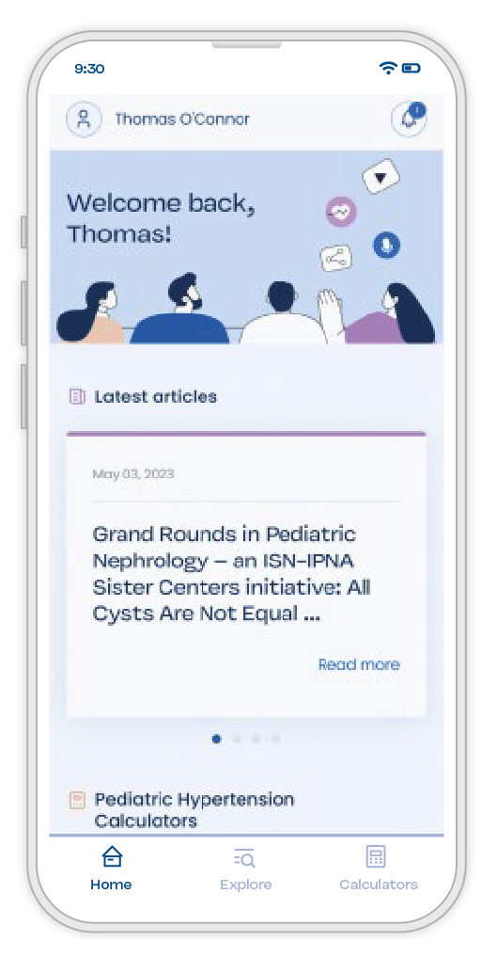
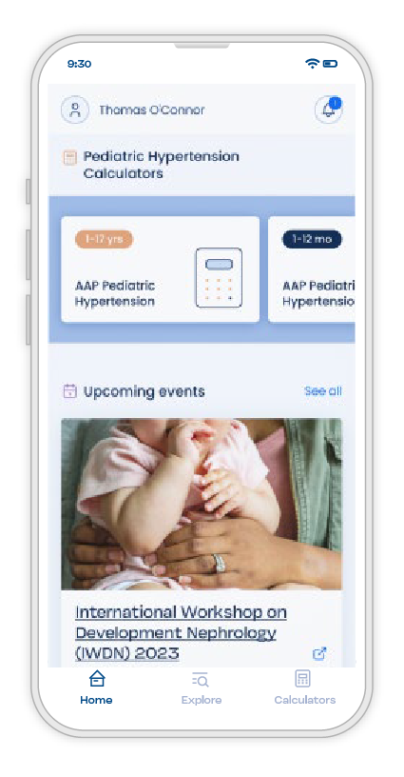
IPNA App
is here!
Discover the wealth of IPNA resources, all at your fingertips! Access them conveniently from your phone and other devices.
Journal and Educational Material
Calculators with Built-in Formulas
Free Downloadable Webinars
Free
IPNA app

Slide 10
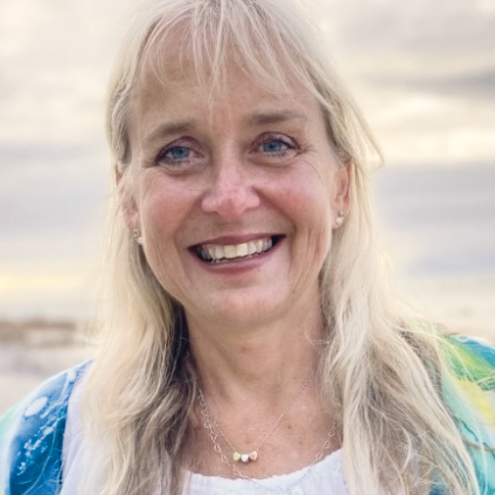
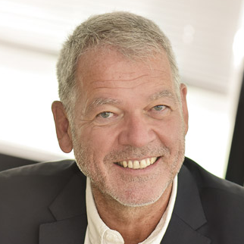
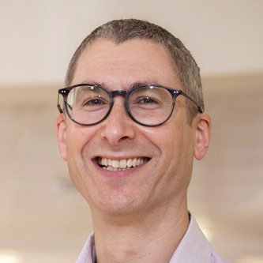
H1
Perex
Paragraph
Li
Organizing Committee
Mignon McCulloch
IPNA Congress President
Rukshana Shroff
Scientific Committee Chair
Pierre Cochat
Scientific Committee Chair
Stephen Marks
Scientific Committee Chair
Patience Sigwadi (Local Organizing Committee), El Gottlich (Local Organizing Committee), Hesham Safouh (AfPNA Councilor), Francis Layla (AfPNA Councilor), Bashir Admani (AfPNA Councilor), Sampson Antwi (AfPNA Councilor)
Registrations
are now open
www.ipna2025.org, www.theipna.org

Slide 11
Follow us on social media channels
H1
Perex
Paragraph
Li
@IPNA.PedNeph
@IPNA_PedNeph
@IPNA_Congress

